Slide 1


GENERATE ARRAYS FROM COLUMN DATA
collect_list() | collect_set()

Slide 2
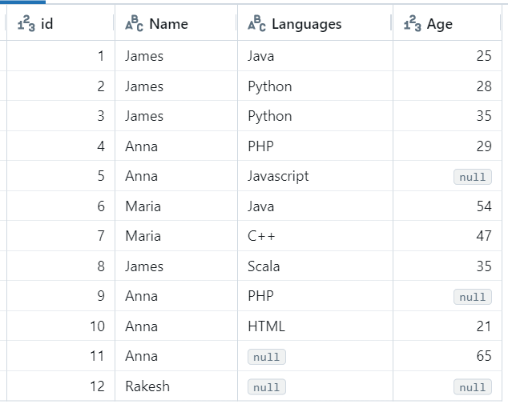
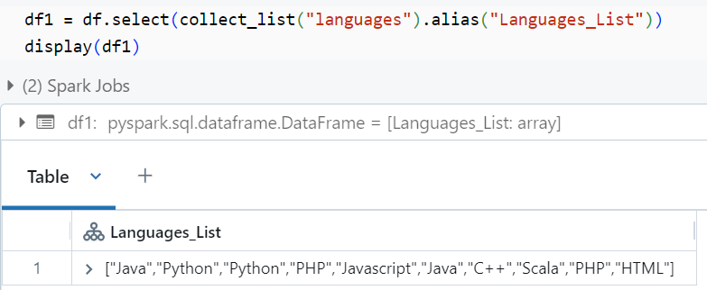
data = [(1, 'James’, 'Java', 25),
(2, 'James’, 'Python', 28),
(3, 'James’, 'Python', 35),
(4, 'Anna’, 'PHP', 29),
(5, 'Anna’, 'Javascript', None),
(6, 'Maria’ ,'Java', 54),
(7, 'Maria’, 'C++', 47),
(8, 'James’, 'Scala', 35),
(9, 'Anna’, 'PHP', None),
(10, 'Anna’, 'HTML', 21),
(11, 'Anna’, None, 65),
(12, 'Rakesh’, None, None)
]
schema = StructType([StructField("id", IntegerType(), False),
StructField("Name", StringType(), False),
StructField("Languages", StringType(), True),
StructField("Age", IntegerType(), True)])
df = spark.createDataFrame(data=data, schema=schema)
display(df)

Slide 3
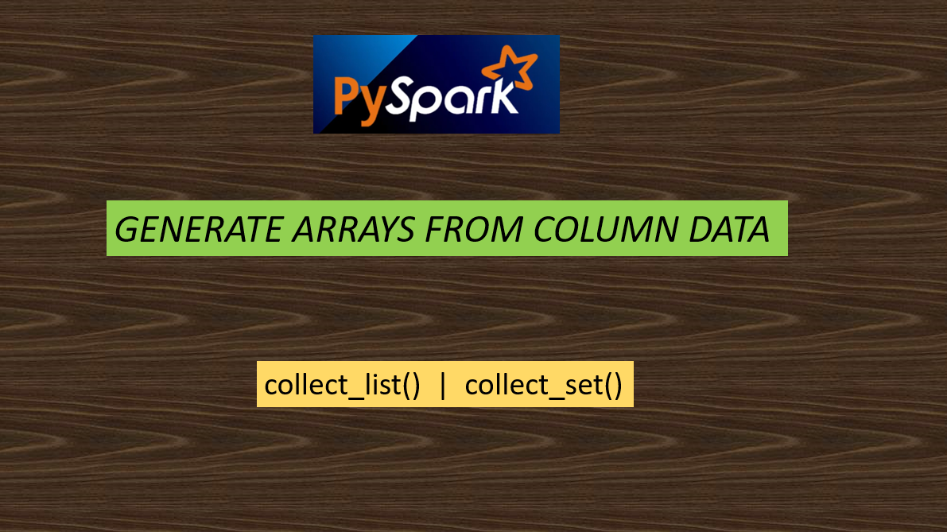

Slide 4
